Slide 1



Memory Elements
EE ASSIGNMENT
20CSE1030
ZubinShah

Slide 2
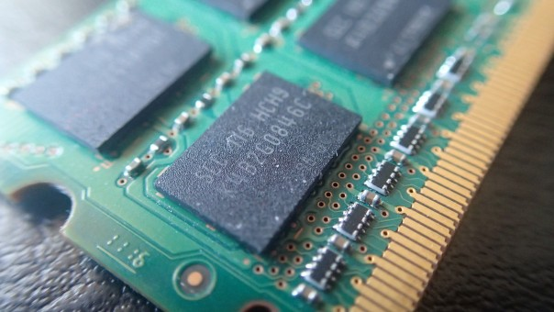

LET US LOOK INTO FOLLOWING MEMORY DEVICES
MEMORY ELEMENTS
RAM
ROM
SRAM
DRAM
PROM
EEPROM
EPROM

Slide 3


RAM
I am volatile
RAM(Random Access Memory) refers to the hardware that provides the memory locations referred to in software as registers.
You can think of RAM as working memory where variables are stored while the CPU performs calculations.
RAM is much faster to access than external memory and is a critical component to the speed of the processor chip.
Ram memory is dislocated when voltage is removed.
Notes:
Notes to presenter:
What is your purpose for sharing this reflection?
Is it at the end of a unit or project?
Are you sharing this reflection, at the attainment of a learning goal you set for yourself?
Is it at the end of a course?
State your purpose for the reflection or even the purpose of the learning experience or learning goal. Be clear and be specific in stating your purpose.

Slide 4

RAM
STATIC
DYNAMIC
Uses several transistor to make up one bit
Architectural Difference
Uses several transistors and capacitors to make up one bit
Do not require periodic refreshment to retain data
Refreshment
Needs periodic refreshment to retain charge in the capacitors for data
SRAM
DRAM
Price?
SRAM
DRAM
Speed?
SRAM
DRAM
Density?
SRAM
DRAM
Complexity?

Slide 5
ROM
I am not volatile
ROM(Read Only Memory) is a type of non volatile memory that cannot be electronically modified after the manufacture of the memory device.
Read-only memory is useful for storing software that is rarely changed during the life of the system, also known as firmware.
The data remains even when there is no continuous power flow., in other words the data is permanent.
Notes:
Notes to presenter:
What is your purpose for sharing this reflection?
Is it at the end of a unit or project?
Are you sharing this reflection, at the attainment of a learning goal you set for yourself?
Is it at the end of a course?
State your purpose for the reflection or even the purpose of the learning experience or learning goal. Be clear and be specific in stating your purpose.

Slide 6


PROM
EPROM
EEPROM
Programmable Read Only memory
Erasable Programmable Read Only memory
Electroically Erasable Programmable Read Only memory
Can be programmed only once by the manufacturer
Can be reprogrammed using Ultraviolet light
Can be reprogrammed using electric charge
Notes:
Notes to presenter:
What was important about this learning experience?
How is it relevant to your course, yourself, or your society or community?
Why is this significant?
This SmartArt allows you add images and text to help outline your process. If a picture is worth a thousand words, then pictures and words should help you communicate this reflection on learning perfectly! You can always click on Insert>SmartArt to change this graphic or select the graphic and click on the Design contextual menu to change the colors.

Slide 7

Thank you

